Slide 1


Minor Project Title: Rail Metro App Using Dijkstra’s And ACO Algorithm
Presented by:
Hitendra Sisodia
Ujesh Sisodia
Arnav Sharma
Kartikay Kanojia
Guided by:
Dr Keshav Sinna
Assistant Professor
School of Computer Science

Slide 2
Introduction.
Welcome to the Rail Metro System for optimizing public transportation routes. Our web application is designed to assist you in planning your journeys with ease. Whether you need to visit multiple destinations, find the quickest routes, or minimize your travel time, we've got you covered.
Challenges: We identify transportation obstacles in unexplored territory, including environmental, engineering, and congestion issues.
Algorithmic Solutions: We use powerful algorithm like Dijkstra’s Algorithm and Ant Colony Optimization Algorithm to efficiently optimize road routing in these areas.
Transportation Improvement: Through algorithmic solutions, we hope to create a more sustainable, efficient, and accessible transportation system that benefits communities and the environment in unexplored areas.

Slide 3
Problem Statement.
Dissatisfaction with inadequate public transportation in less developed regions and congested travel plans can be addressed, aligning with the smart city objective of enhancing living standards and promoting economic growth.
Create an innovative and effective solution to address inefficiencies in public transportation systems, with a focus on improving route planning to increase overall system efficiency, decrease travel times, and improve the customer experience.

Slide 4
Motivation.
Congestion in Cities: Many cities throughout the world are grappling with transportation challenges, including longer travel times and a lower quality of life due to limited and inefficient public transportation options. A well-optimized static route system can significantly enhance urban mobility and improve the overall commuting experience.
Environmental Sustainability: Reducing the number of private vehicles on the road through improved public transportation efficiency is an important step toward reducing carbon emissions.
Economic Advantages: Efficient public transportation networks can attract businesses, visitors, and residents, boosting local economies and expanding job opportunities.
Passenger Satisfaction: Improving the passenger experience by shortening wait times, offering dependable services, and streamlining routes might attract more people to use public transit, resulting in a more sustainable method of transportation

Slide 5
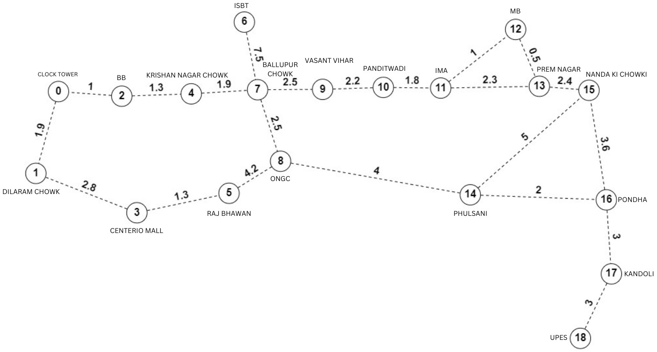
Objectives.
Brute Force Algorithm:
Develop and implement a static route calculation algorithm suitable for public transportation networks, ensuring efficient route planning without considering real-time traffic data.
Network Representation:
Create a comprehensive representation of the static public transportation network as a graph, with nodes representing stops or stations and edges representing routes between them.
3. User-Friendly Interface:
Design an intuitive user interface that enables users to input their origin and multiple destinations, selecting from static routes, and receive optimized route suggestions within the public transportation network.
4. Efficiency Enhancement:
Enhance public transportation efficiency by providing commuters with accurate, static route recommendations, reducing travel time, and improving the overall reliability of the transportation system.

Slide 6
Tech Stack.
Version Control:
Git, GitHub/GitLab
Programming Language:
Java
Integrated Development Environment (IDE):
VS-code
Frontend:
JavaFX GUI
Deployment:
AWS(Amazon Web Service)

Slide 7
Methodology.
1. Graph Representation: Create a graph data structure to represent the highway network based on the static dataset. Vertices represent cities or intersections, and edges represent roads connecting them.
2. Route Calculation Algorithm: Implement a routing algorithm (Brute Force Approach) to calculate the shortest route between two cities based on the graph representation.
3. User Interface Development: Choose a user interface development framework.
4. Design and create a user interface that includes: Input fields for specifying the start and multiple end cities, routes and the total distance and total duration.

Slide 8
Methodology (contd).
5. User Interaction: Allow users to input start and multiple end cities through the user interface. Trigger the routing algorithm to calculate the shortest route when the user requests it.
6. Route Display: Display the calculated route on the map in the user interface. Show route information, including the list of cities on the route and the total distance and total duration.
7. Testing: Test the routing algorithm for accuracy by comparing results with a known static dataset. Conduct user testing to ensure the interface is intuitive and functional.
8. Documentation: Create user documentation explaining how to use the application. Document the code and algorithms for future reference.

Slide 9
c
Implementation.
Interface Design Develop a user-friendly CLI/GUI for interacting with the routing service.
2. Route Calculation Logic: Implement Brute Force algorithm considering API data.
3. Implement the Interface: Define flexible interface methods for route calculation.
4. Demonstration: Showcase the routing service with the chosen interface.

Slide 10
Application of the Project.
Emergency Services: Improved routing efficiency can be crucial for emergency response teams, allowing them to arrive at accident or catastrophe sites sooner and more effectively, potentially saving lives.
Tourism and Navigation: Tourism and navigation apps can use efficient routing algorithms to give tourists and travellers with the best routes to their destinations, thereby encouraging tourism and improving user experience.
Trip Planner: A trip planner can be used to optimize public transportation routes in urban areas. By providing efficient routes and schedules for buses, trams, and trains, it can encourage more people to use public transport, reduce traffic congestion, and minimize the environmental impact of commuting.
Rural and Remote Areas: Rural and isolated locations deal with particular transportation issues; this project can improve accessibility and connectivity for these places, potentially increasing their economic development and quality of life.

Slide 11
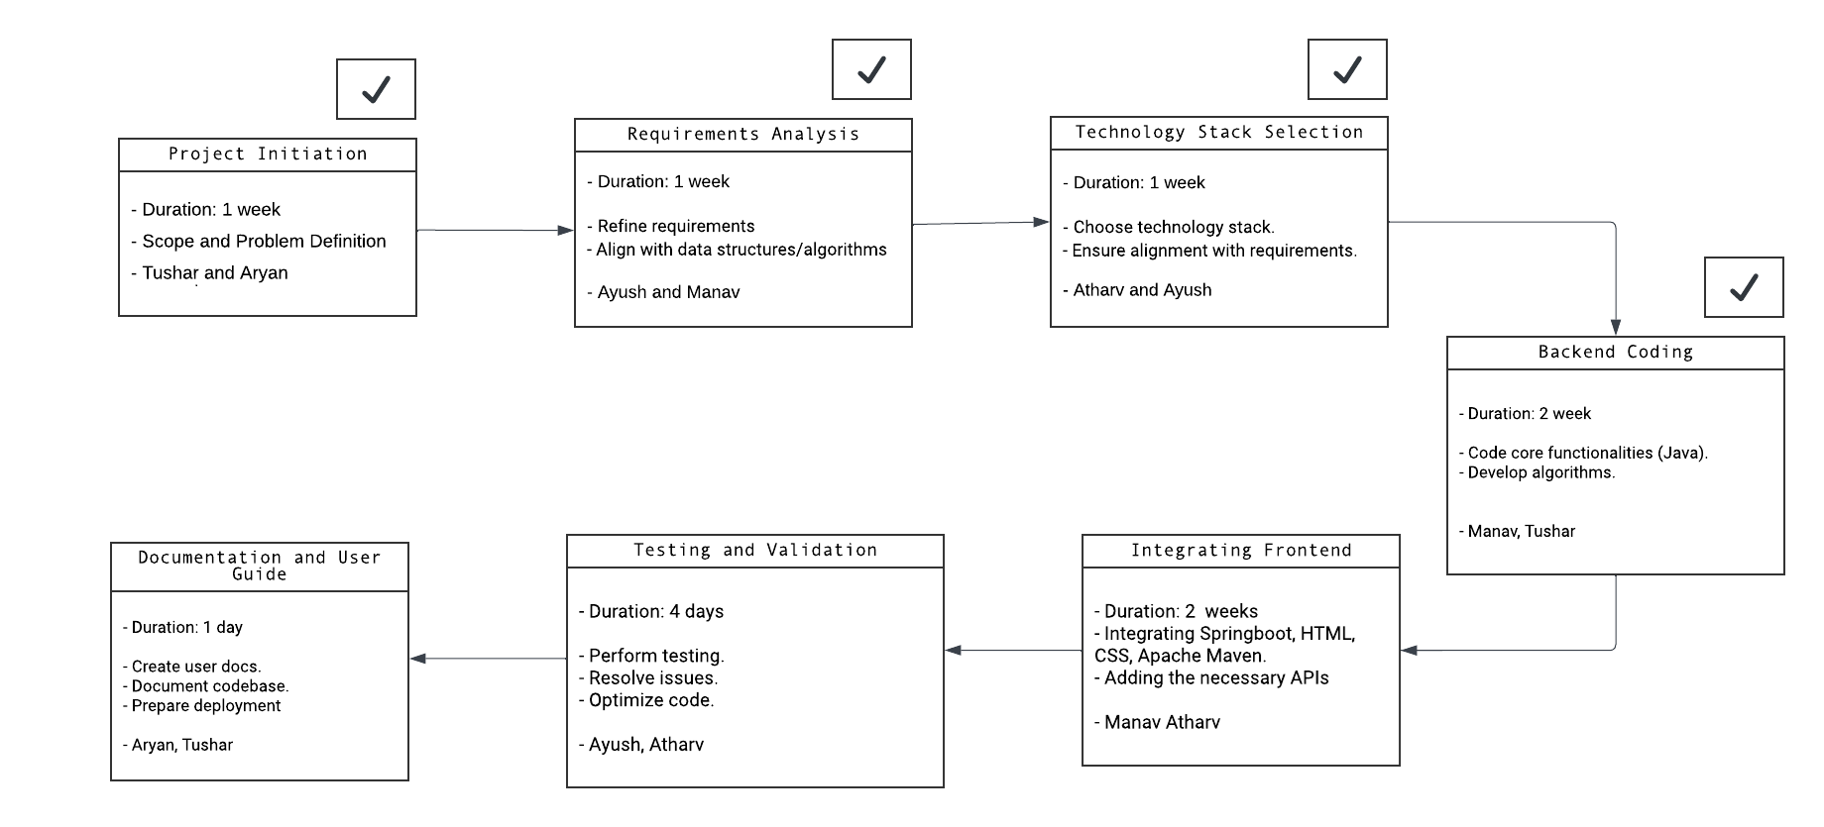
PERT Chart.
Ujesh and Hitendra
Arnav
Kartikay
Hitender
Arnav
Hitender
Ujesh

Slide 12
References.
Smith, J. (Year). "User Behavior Analysis for Public Transportation Mobile Apps." Journal of Transportation Technology, 20(3), 345-360.
Brown, A., & Lee, C. (Year). "Impact of Mobile Ticketing on Metro Rail Commuter Satisfaction." Transportation Research Part A: Policy and Practice, 45(8), 678-692.
Johnson, R. (Year). "Mobile App Development for Urban Transportation." Publisher.
Williams, S., & Davis, M. (Year). "User-Centered Design for Mobile Applications." Publisher.

Slide 13
Thank
you.

